Slide 1
Master Artifact
VDS Retail Expansion
Andrew Pendleton
CX Design Systems
Core Product
Project

Slide 2
Verizon Design Systems
Executive Summary | Retail Expansion
Strategic Themes
North Star
Leads
01
Introducing "VDS for Retail": a purpose-built expansion of our core VDS, tailored for the unique demands of in-store digital interfaces. Retail designers will define the components, and the VDS team will initially develop them, ensuring quality and consistency. This provides a ready-made, expert toolkit to transform our retail digital presence.
This initiative will deliver a specialized VDS toolkit for our unique Retail experiences, kiosks, POS, passive displays, ensuring seamless, on-brand customer interactions. This is creating a new model for VDS: a core system that grows through expansion packs to better support every customer touchpoint.
Andrew Pendleton
Workstream Lead
Andrew Pendleton
Initiative Lead
Mobile
Fios
FWA
Scale
02
Customer Impact
Retail design and development teams will be empowered with VDS components crafted specifically for their unique environments. This means faster design cycles, streamlined development, and the ability to rapidly deploy consistent, high-quality, and accessible retail experiences. They can focus on retail innovation, backed by VDS precision.
KPIs Impacted
P*Q
$-
Incr. Revenue
$-
Call Volume Opt.
Customer Satisfaction
Digital Interaction Score
03
Business Impact
$-
Handle Time Opt.
$-
Other Benefit Value
This initiative will electrify our in-store brand presence and customer engagement on all retail digital touchpoints. Expect improved transaction speed, enhanced customer satisfaction in stores, and a stronger, unified brand story. Crucially, "VDS for Retail" validates a scalable model for future VDS specializations, boosting system ROI and adaptability.
Other Cost Savings
$TBDM
Total 2026 Capex + Opex
Incremental Request

Slide 3
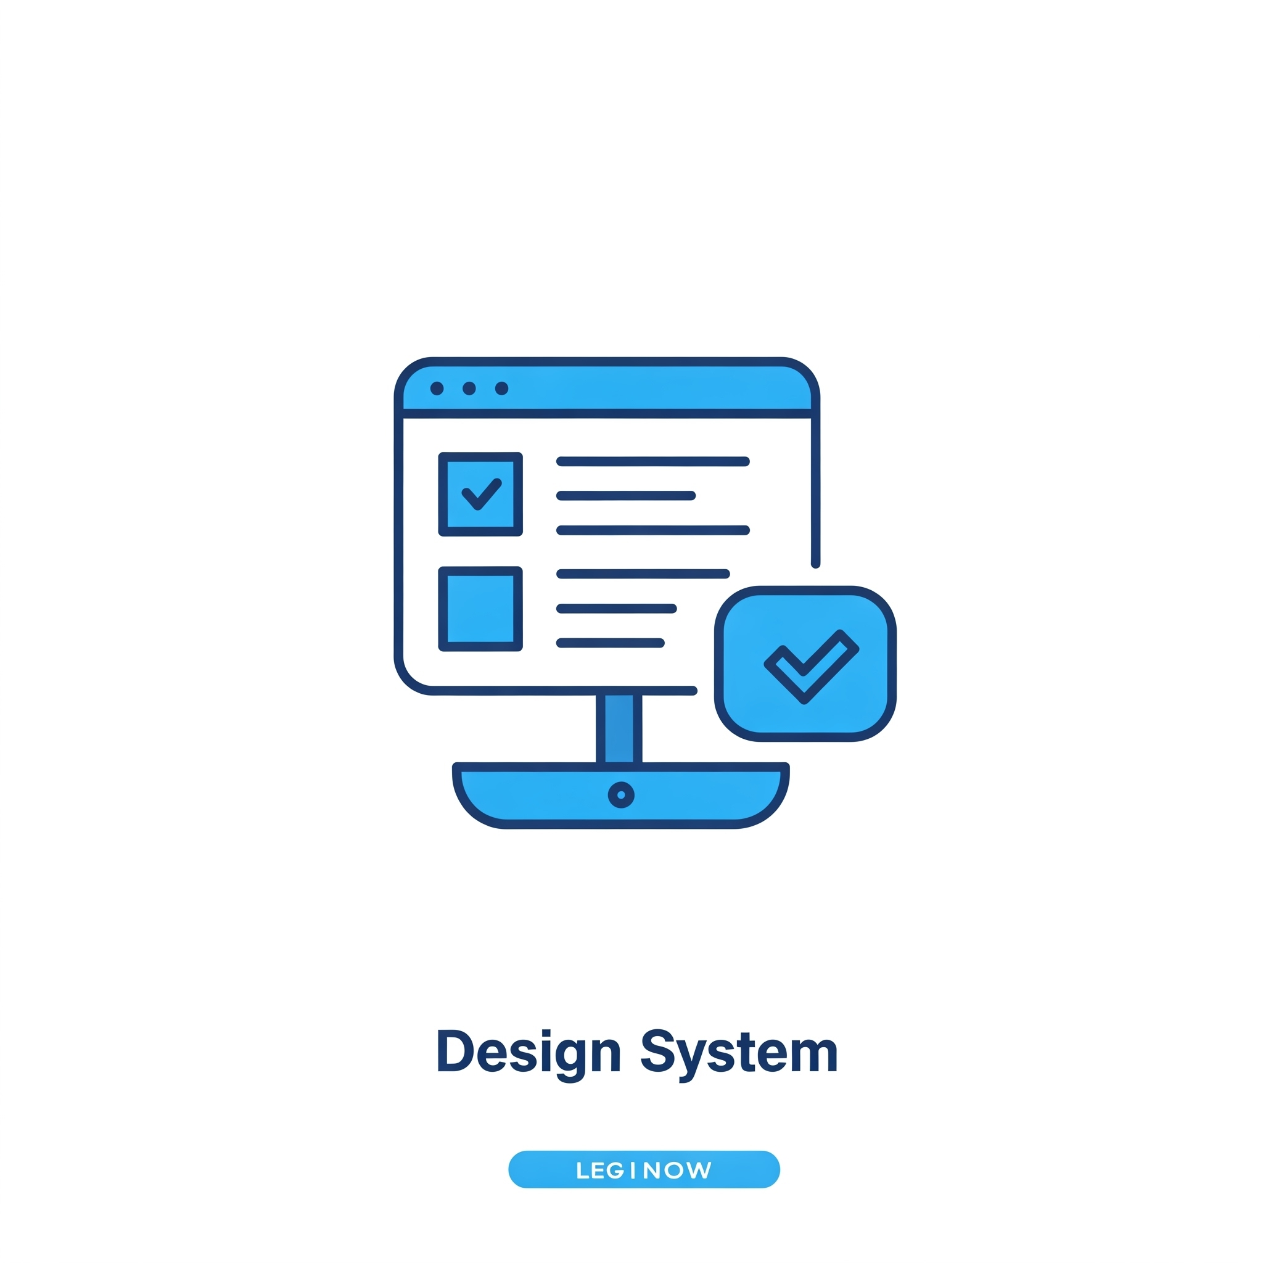
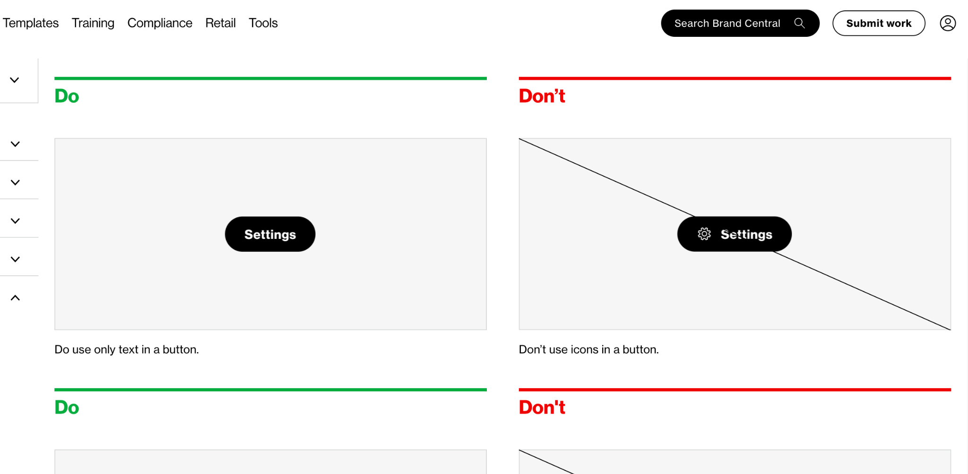
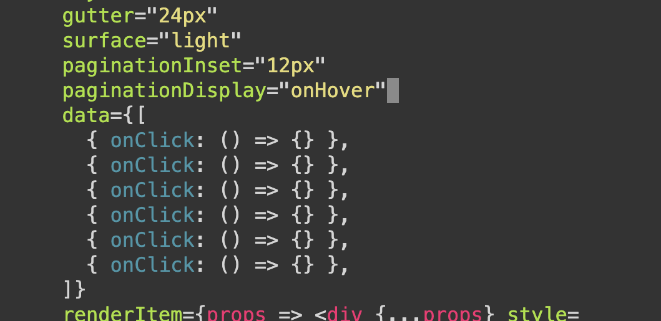
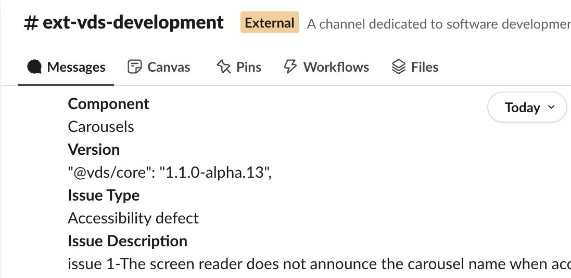
Verizon Design System
Journey Map | Retail Expansion
Documentation & Guidelines
The VDS Retail expansion will feature comprehensive documentation and clear guidelines, serving as the single source of truth for developers. These resources will detail retail specific principles, component APIs, platform-specific usage, accessibility standards, and contribution models. The impact is immediate: teams are empowered with actionable knowledge, speeding up onboarding and ensuring consistent, high-quality, and compliant retail experiences.
React Coded Components
Developers will primarily utilize our production-ready VDS Coded Components for React development.
These easily installable, rigorously tested, and performant libraries are built with accessibility and theming at their core.
The impact is a dramatic reduction in retail development time and effort, as these reusable building blocks minimize custom code, ensure consistency, improve quality, and free up developers to focus on core business logic.
Support & Feedback Developers will benefit from our VDS Retail support channels, including a responsive Slack community and VDS team office hours.
With clear processes for bug reporting, feature requests, and feedback collection, we ensure continuous improvement.
This provides a crucial safety net, unblocking users quickly and fostering a collaborative partnership where feedback directly shapes a more robust, user-centric native library.

Slide 4

VDS Retail Expansion
VDS Product: Expansion Strategy
Workstream Lead: Andrew Pendleton
Initiative Lead: Andrew Pendleton
Northstar
Scope
Results
The Idea
Problem & Opportunity
Our vital in-store digital experiences (kiosks, POS, displays) currently operate without dedicated VDS components. The teams are able to utilize our core VDS component set but these do not fully meet the specific challenges faced within the Retail channel. The lack of Retail specific components creates a critical gap, risking inconsistent branding, slower rollouts, and subpar user engagement where customers make key decisions. We don’t want to miss the opportunity to deliver truly unified, high-quality experiences in our retail footprint.
Proposed Solution
Introducing "VDS for Retail": a purpose-built expansion of our core VDS, tailored for the unique demands of in-store digital interfaces. Retail designers will define the components, and the VDS team will initially develop them, ensuring quality and consistency. This provides a ready-made, expert toolkit to transform our retail digital presence.
Customer Impact
Retail design and development teams will be empowered with VDS components crafted specifically for their unique environments. This means faster design cycles, streamlined development, and the ability to rapidly deploy consistent, high-quality, and accessible retail experiences. They can focus on retail innovation, backed by VDS precision.
Business Impact
This initiative will electrify our in-store brand presence and customer engagement on all retail digital touchpoints. Expect improved transaction speed, enhanced customer satisfaction in stores, and a stronger, unified brand story. Crucially, "VDS for Retail" validates a scalable model for future VDS specializations, boosting system ROI and adaptability.
This initiative will deliver a specialized VDS toolkit for our unique Retail experiences, kiosks, POS, passive displays, ensuring seamless, on-brand customer interactions. This is creating a new model for VDS: a core system that grows through expansion packs to better support every customer touchpoint.

Slide 5
Expected Results
Northstar
Scope
Results
CX Workstream Name
KPI’s Impacted- Section 1
CX Excellence
❎ | Customer Satisfaction (CSAT) |  |  |  | ⬜ | Rep Interaction Score (RIS) |  |  |  | ⬜ | Churn Reduction
⬜ | 3-day Resolve |  |  |  | ❎ | Digital Interaction Score (DIS)
Revenue Growth
⬜ | Service Product Revenue |  |  |  |  | ⬜ | Overall Conversion
⬜ | Service Product Revenue |  |  |  |  | ⬜ | Prospect Conversion
Operational Efficiency
⬜ | Call Volume Optimization (CVO) |  |  |  |  |  | ⬜ | Average Handle Time (AHT)
⬜ | Retail Transaction Time |  |  |  |  |  | ❎ | Other Cost Savings
Financial Scope & Targets (P*Q)- Section 2
Benefit Value Estimates
Incremental Revenue $_______ Call Volume Optimization $________ Handle Time Optimization $_______ Other Benefit Value $________ (please explain)
Investment Planning - Section 3 (CXO IPG to complete this section)
Capital Investment Estimates
GTS Labor estimate $__________ Non-GTS estimate $__________
Operating Expense for Initiative (Incremental) CXO Operating Cost (OPEX) $________ CXO Incremental Headcount ________
Notes:
Add in a grey box over area that business should not complete for clarity, re-org details

Slide 6
2026 Capex + Opex Incremental
Northstar
Scope
Results
Xxx (i.e. Koenders, Butler etc.) | xxx (i.e. CX, Experience Product, Digital Channel etc.)
Status | Opex ID | Product Area | EMR (see notes) | Initiative Name | Vendor Name | Description | Budget
C | Opex-xxx | Assisted Experience | Contracted Services | <Name> | <Vendor> | <Description> | $XXX.XX
N | New
C | Continue
S | Stop
Notes:
Expense Management Record (EMR) Categories
Advertising and Promotion
Contracted Services
Direct Costs
Full Time Labor
HR and Training
IT and Technology Contracts
Other Operating Costs
Overhead Costs
Professional Services Fees
Sales Incentives
Temporary Labor
Travel and Internal Events

Slide 7
2026 Opex Only
Northstar
Scope
Results
Xxx (i.e. Koenders, Butler etc.) | xxx (i.e. CX, Experience Product, Digital Channel etc.)
Status | Opex ID | Product Area | EMR (see notes) | Initiative Name | Vendor Name | Description | Budget
C | Opex-xxx | Assisted Experience | Contracted Services | <Name> | <Vendor> | <Description> | $XXX.XX
N | New
C | Continue
S | Stop
Notes:
Expense Management Record (EMR) Categories
Advertising and Promotion
Contracted Services
Direct Costs
Full Time Labor
HR and Training
IT and Technology Contracts
Other Operating Costs
Overhead Costs
Professional Services Fees
Sales Incentives
Temporary Labor
Travel and Internal Events

Slide 9
Master Artifact
Initiative Name
Submitter Name
Band 5 Team Name
Core Product
Project

Slide 10
2026 CXO Planning
For CX Strategy Use - Do Not Fill Out
Workstream Name | Initiative Name TEMPLATE
Northstar:
Strategic Themes
Journey Map
01
Program goal
Key activity
Key activity
Key activity
Key activity
High-level program goal description/objective
02
Program goal
Key activity
Key activity
Key activity
Key activity
High-level program goal description/objective
03
Program goal
High-level program goal description/objective
Expected Outcomes
Expected Results
04
Program goal
Name of KPI
Name of KPI
$XX
Incr. Revenue
$XX
Call Volume Opt.
High-level program goal description/objective
05
Program goal
Name of KPI
Name of KPI
$XX
Handle Time Opt.
$XX
Other Benefit Value
High-level program goal description/objective
Name of KPI
Name of KPI
$XXM
Total 2026 Capex + Opex
Incremental Request

Slide 11
Initiative Name
Workstream Name
Workstream Lead: Name
Initiative Lead: Name
Template
Northstar
Scope
Results
Strategic Themes
[EXAMPLE] Customer need or problem being solved
Giving customers visibility and creating end to end ownership on issues that we cannot resolve on the initial interaction
Customer need or problem is being solved
[What will be unlocked for the customer or business?]
Customer need or problem being solved
[What will be unlocked for the customer or business?]
Customer need or problem being solved
[What will be unlocked for the customer or business?]
Customer need or problem being solved
[What will be unlocked for the customer or business?]
[Northstar statement - Ambition Here]

Slide 12
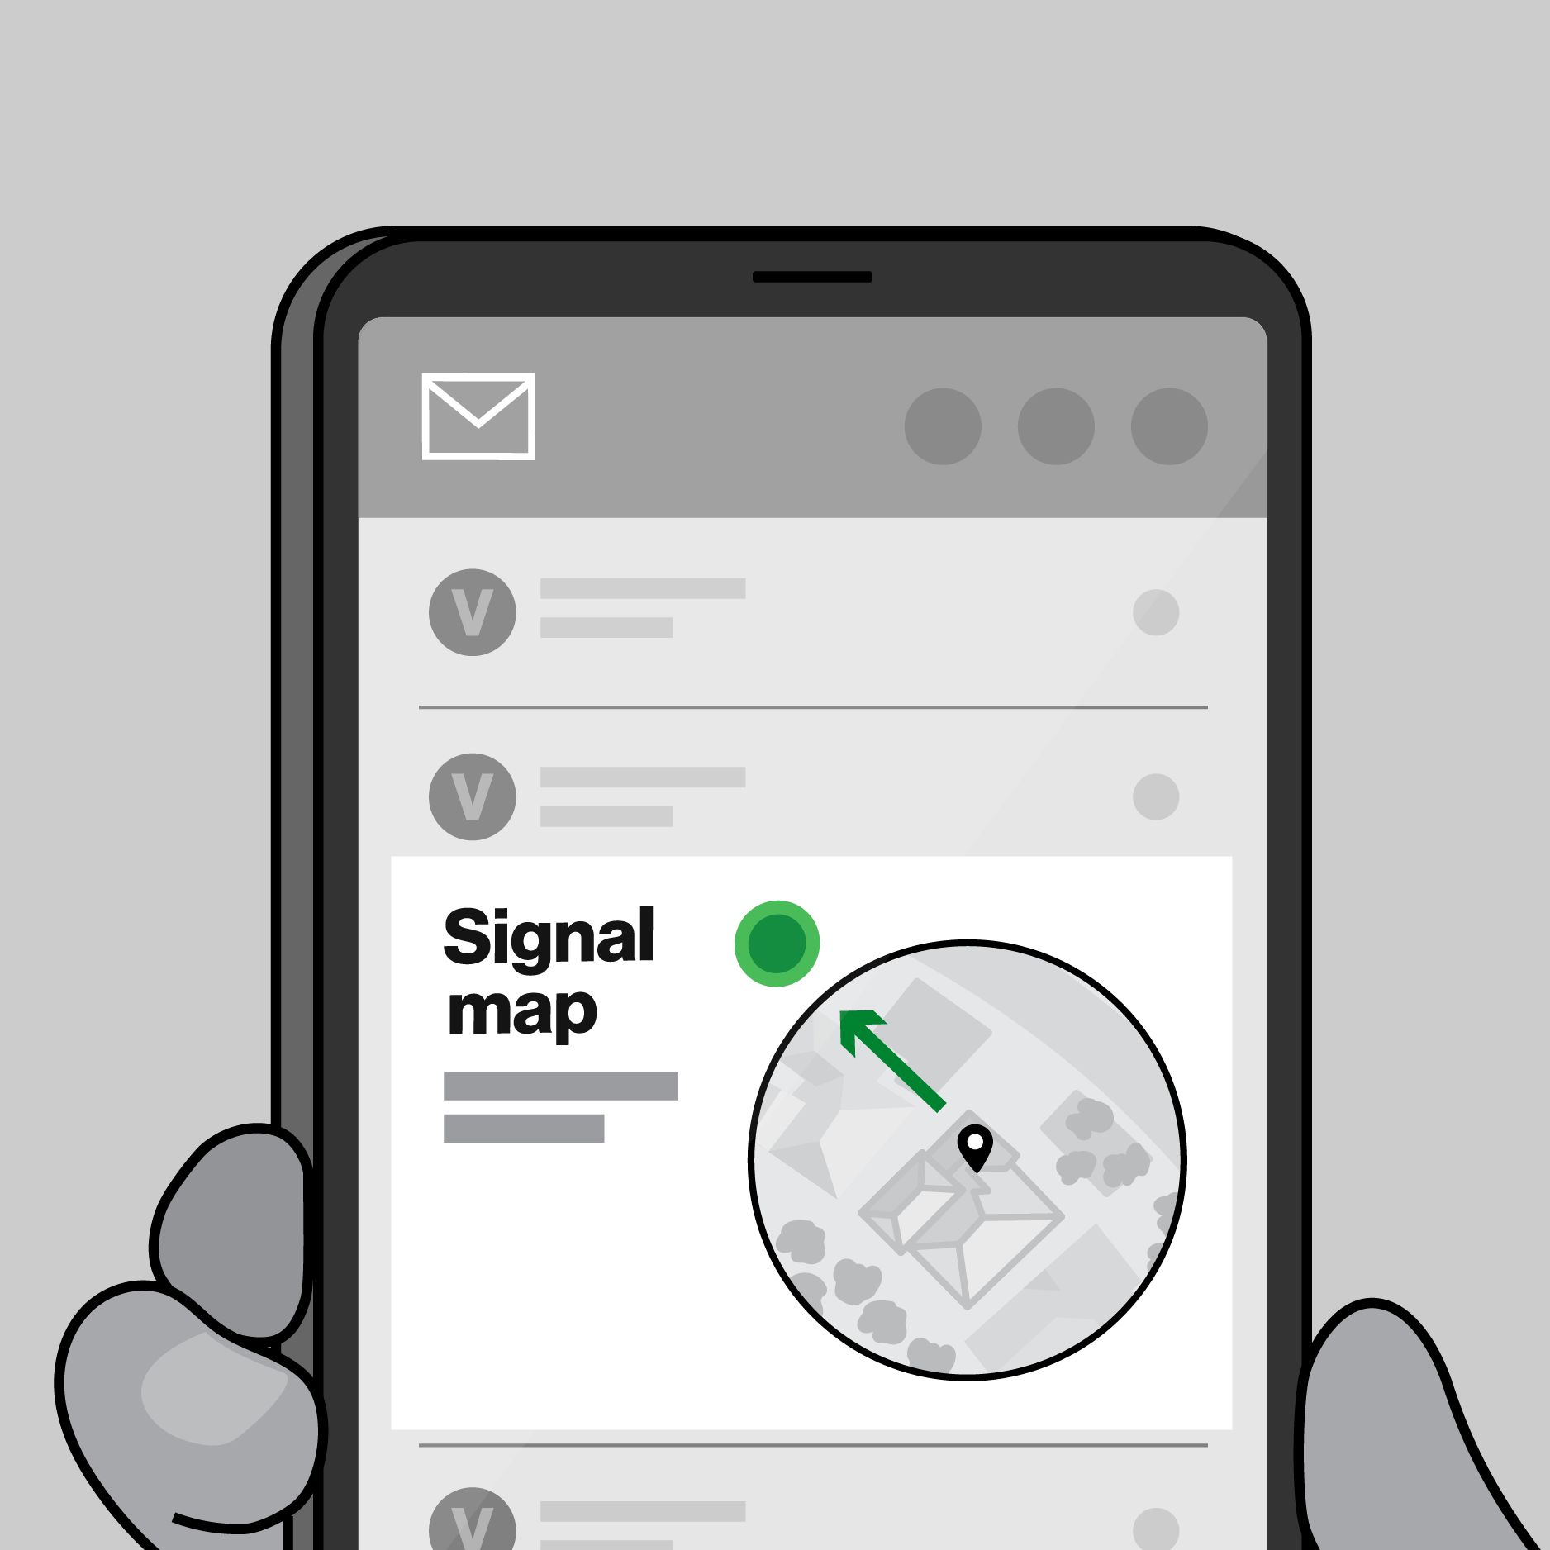
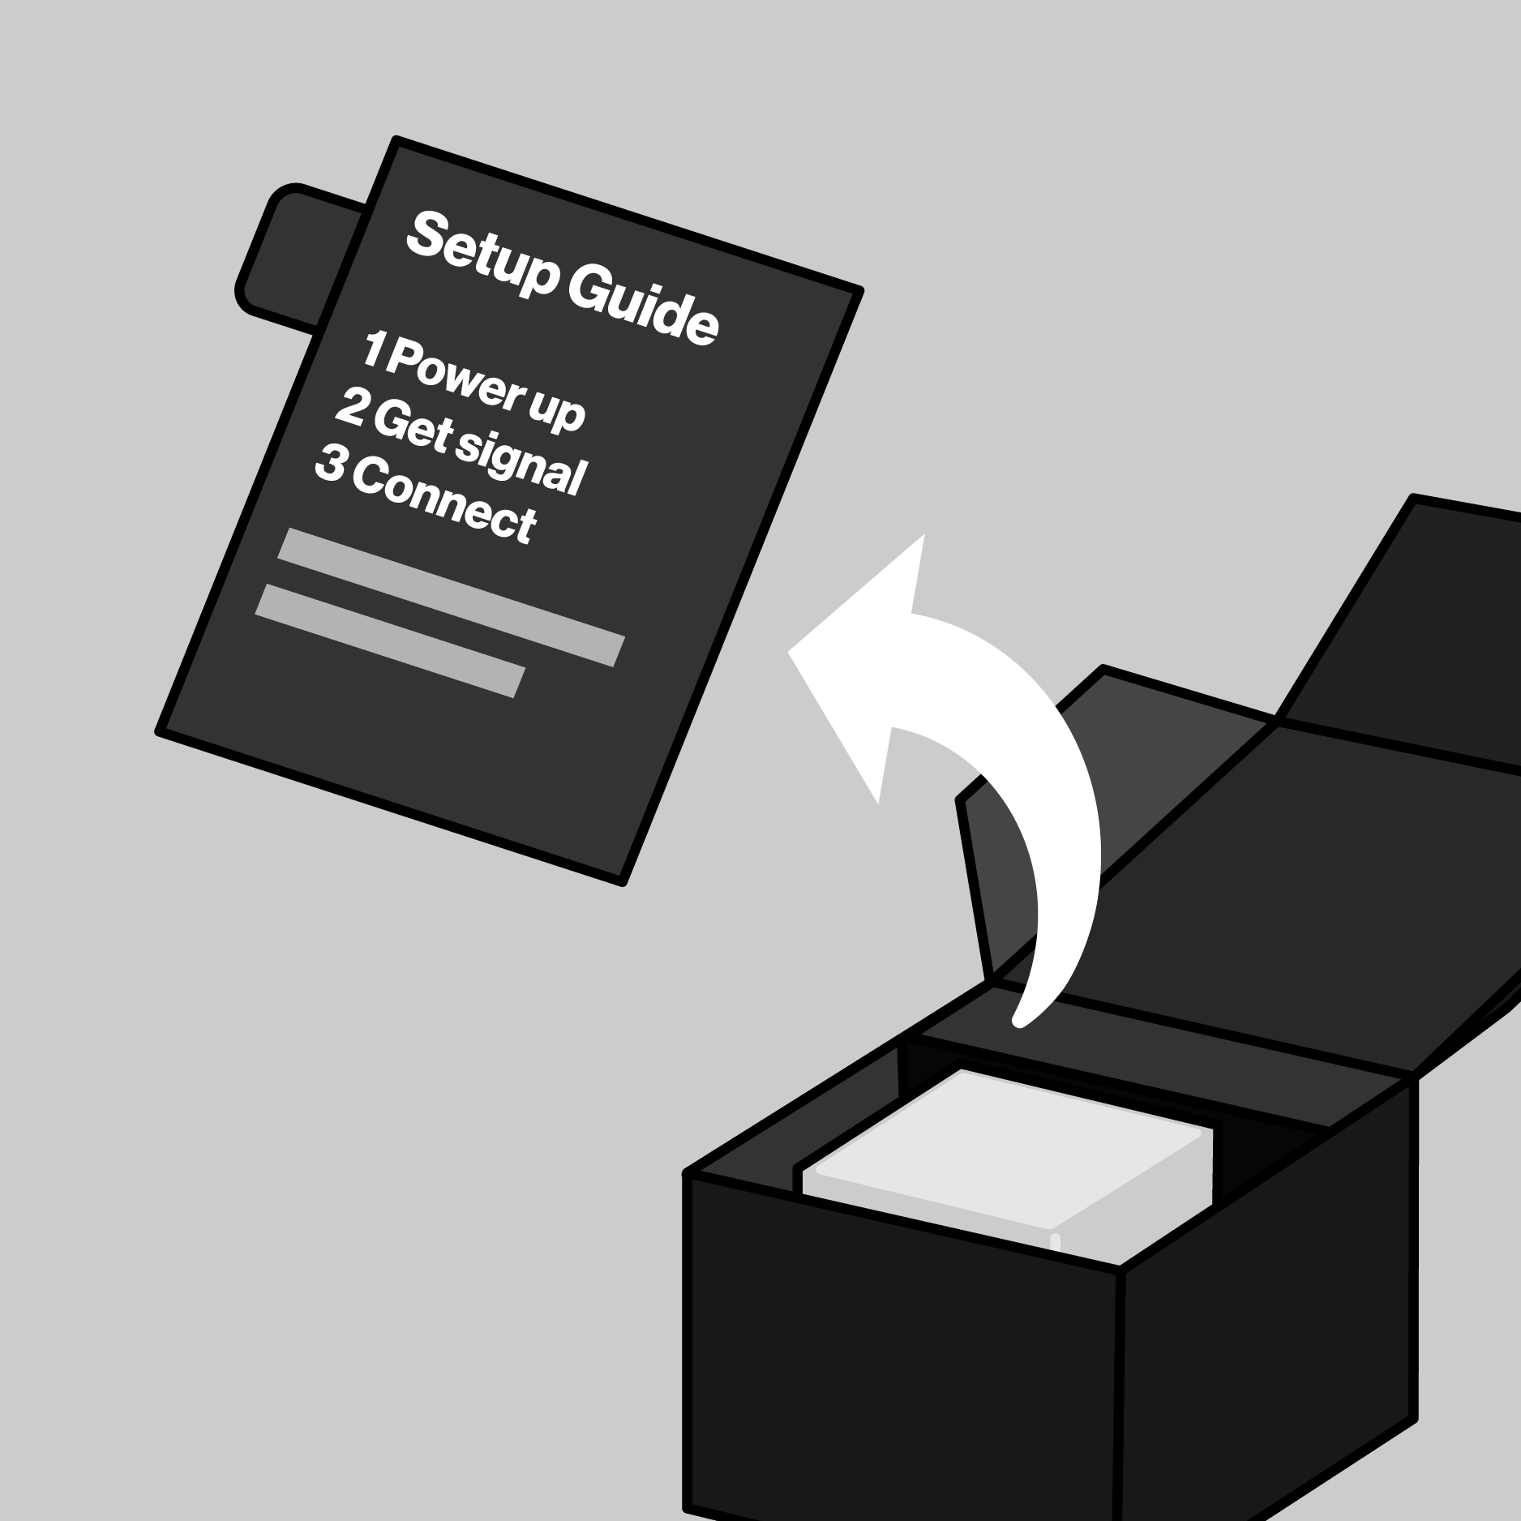


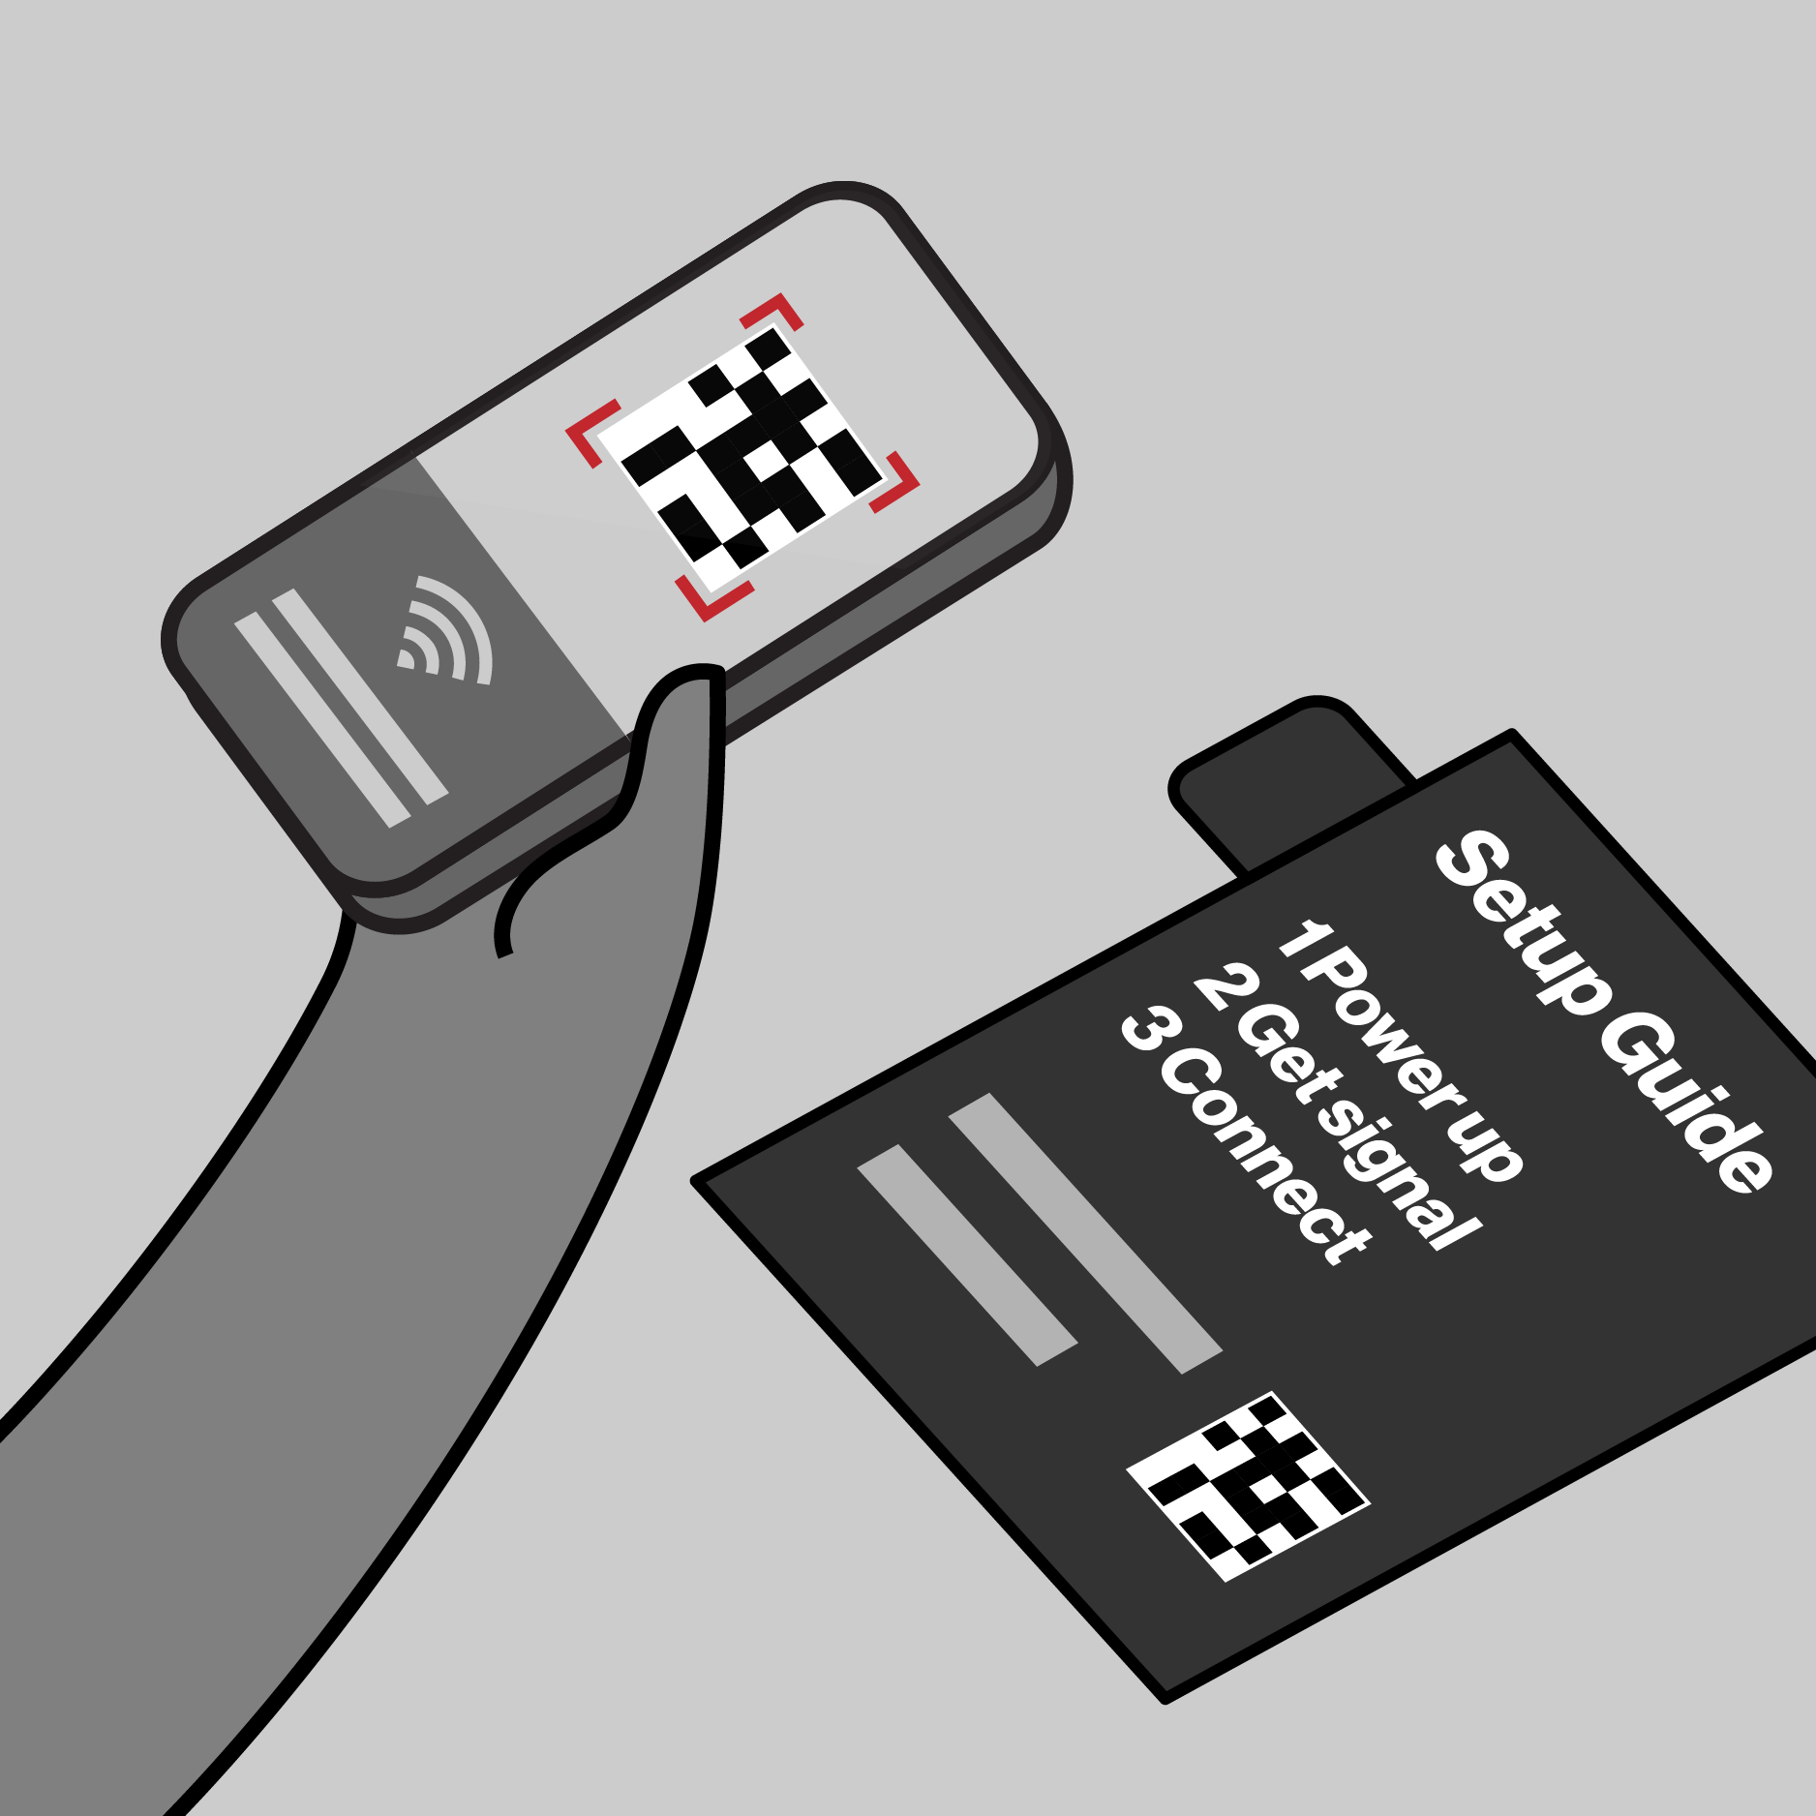
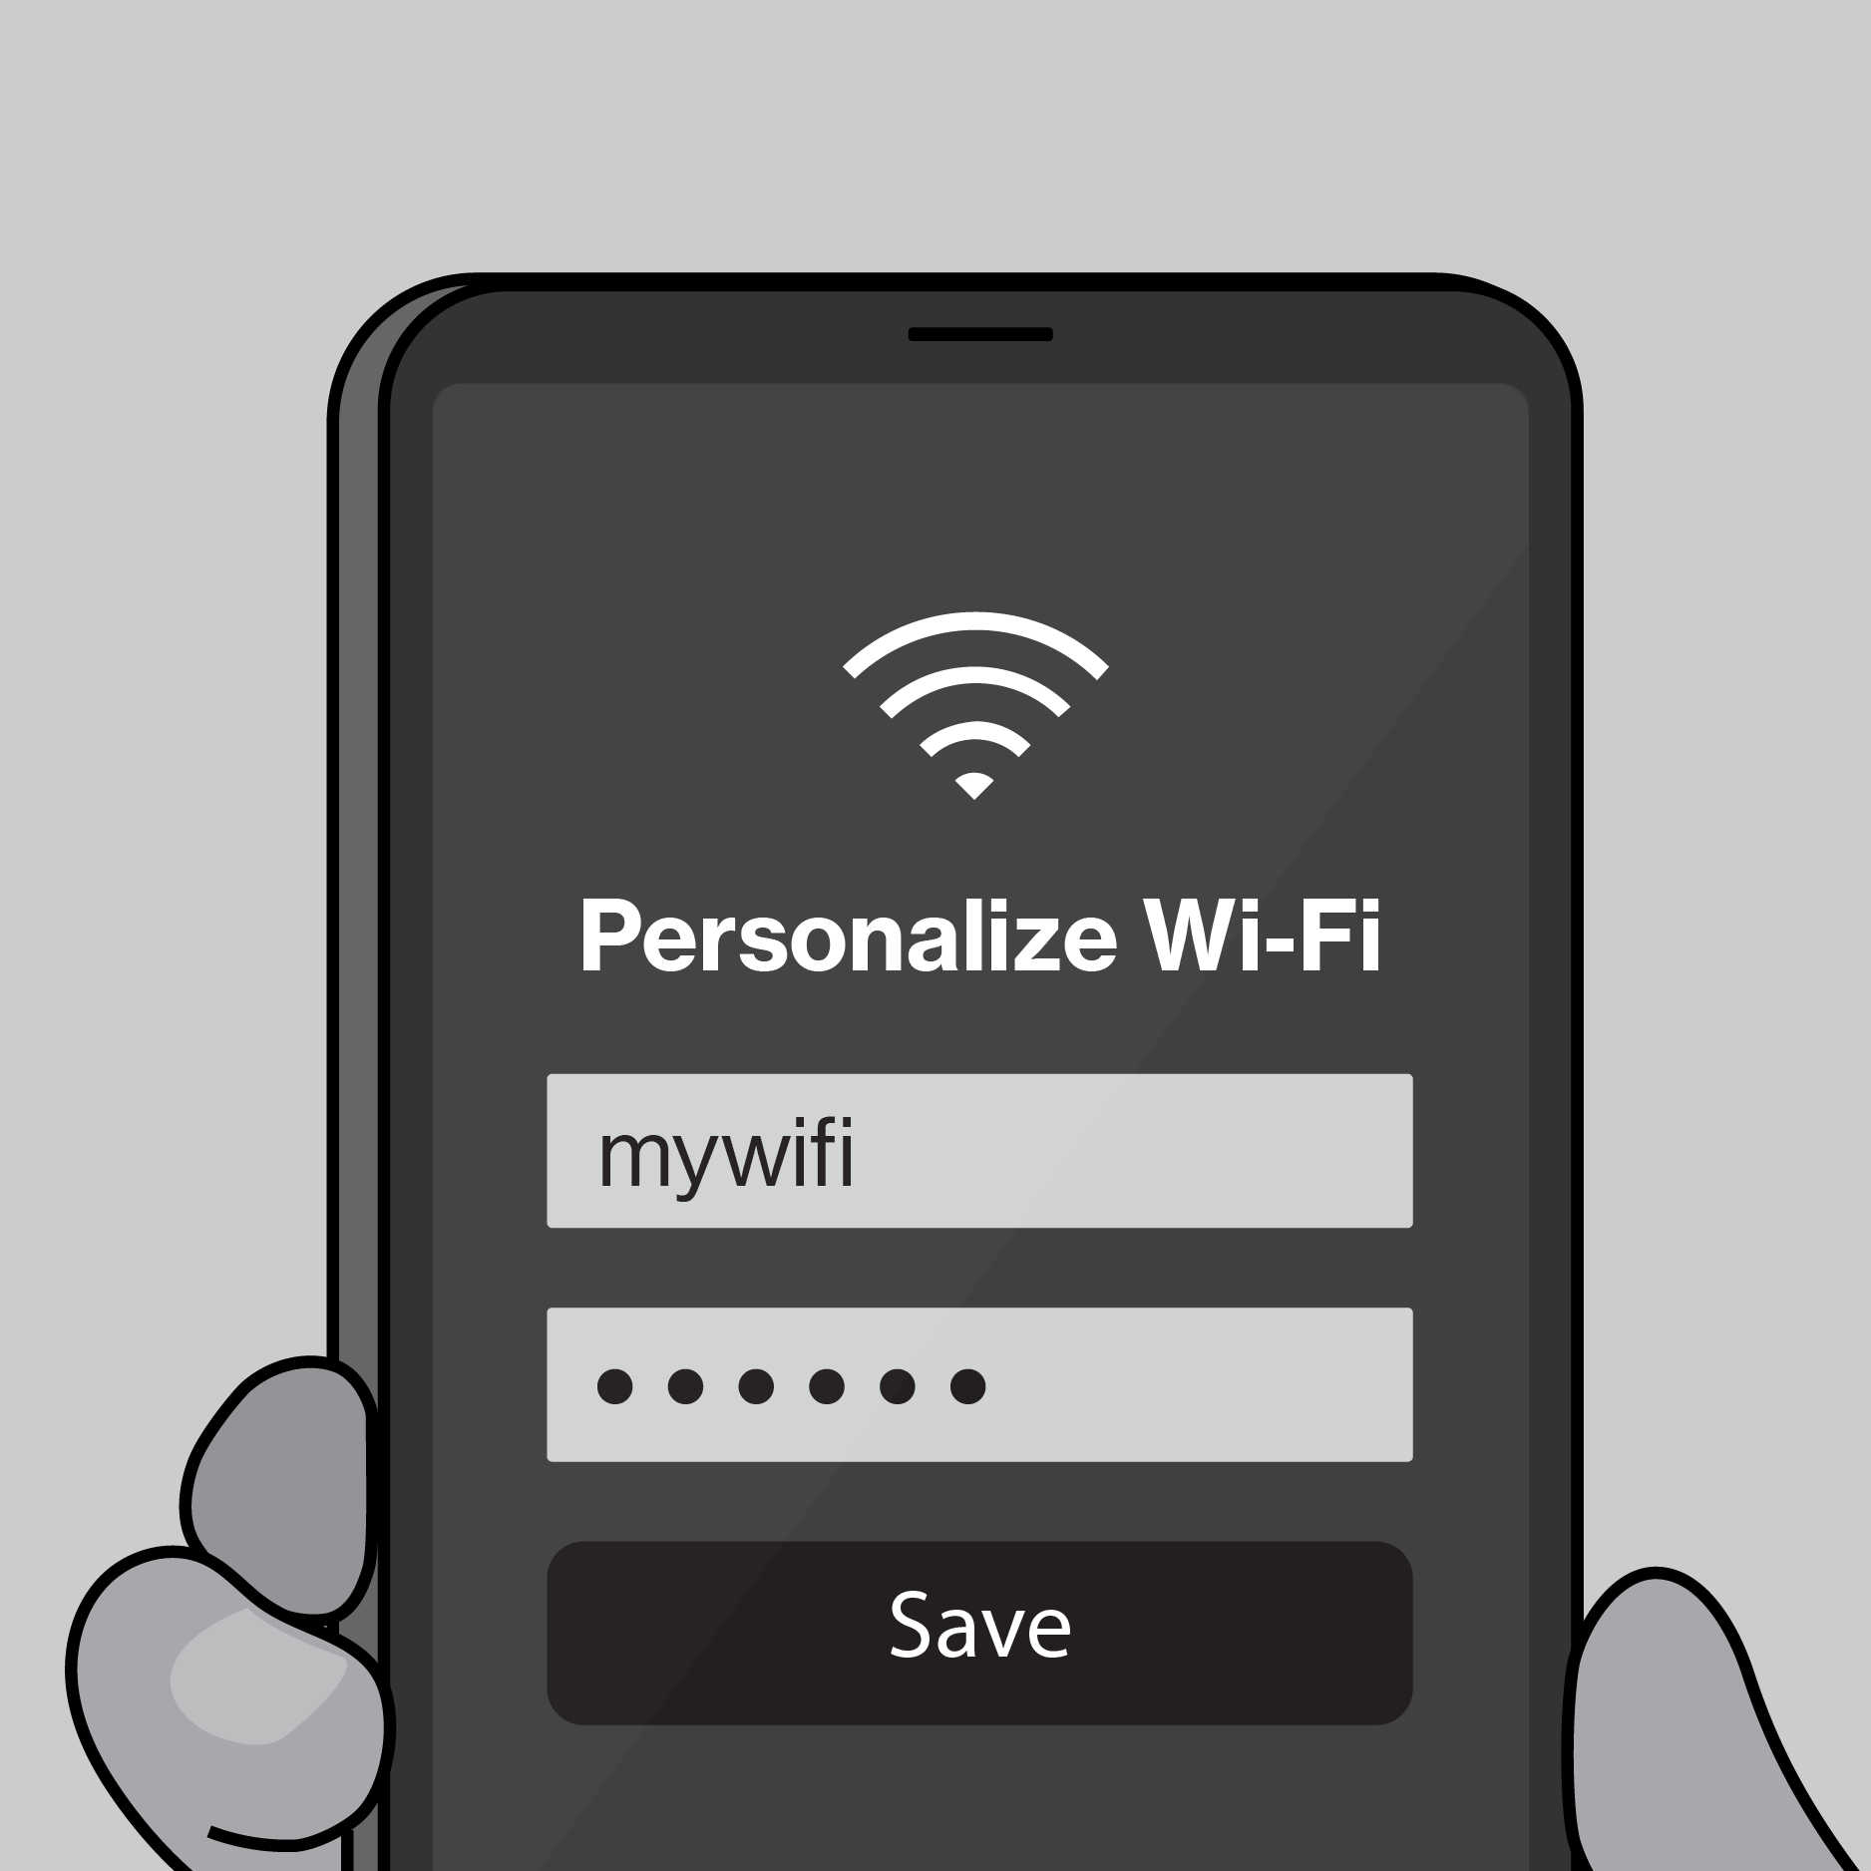

Template
Northstar
Scope
Results
CX Workstream Name
Journey Map Template
Illustrative Only
Key Customer Actions
Description customer objectives and actions
Key Customer Actions
Description customer objectives and interactions
Key Customer Actions
Description customer objectives and interactions
Key Customer Actions Description customer objectives and interactions
Key Customer Actions
Description customer objectives and interactions
Key Customer Actions
Description customer objectives and interactions
Key interactions
Key Interactions w/ Verizon
Key Interactions w/ Verizon
Key Interactions w/ Verizon
Key Interactions w/ Verizon
Key Interactions w/ Verizon
Key Interactions w/ Verizon

Slide 13
Expected Results
Template
Northstar
Scope
Results
CX Workstream Name
KPI’s Impacted- Section 1
CX Excellence
⬜ | Customer Satisfaction (CSAT) |  |  |  | ⬜ | Rep Interaction Score (RIS) |  |  |  | ⬜ | Churn Reduction
⬜ | 3-day Resolve |  |  |  | ⬜ | Digital Interaction Score (DIS)
Revenue Growth
⬜ | Service Product Revenue |  |  |  |  | ⬜ | Overall Conversion
⬜ | Service Product Revenue |  |  |  |  | ⬜ | Prospect Conversion
Operational Efficiency
❎ | Call Volume Optimization (CVO) |  |  |  |  |  | ⬜ | Average Handle Time (AHT)
⬜ | Retail Transaction Time |  |  |  |  |  | ⬜ | Other Cost Savings
Financial Scope & Targets (P*Q)- Section 2
Benefit Value Estimates
Incremental Revenue $_______ Call Volume Optimization $________ Handle Time Optimization $_______ Other Benefit Value $________ (please explain)
Investment Planning - Section 3 (CXO IPG to complete this section)
Capital Investment Estimates
GTS Labor estimate $__________ Non-GTS estimate $__________
Operating Expense for Initiative (Incremental) CXO Operating Cost (OPEX) $________ CXO Incremental Headcount ________
Notes:
Add in a grey box over area that business should not complete for clarity, re-org details

Slide 14
2026 Capex + Opex Incremental
Northstar
Scope
Results
Xxx (i.e. Koenders, Butler etc.) | xxx (i.e. CX, Experience Product, Digital Channel etc.)
Status | Opex ID | Product Area | EMR (see notes) | Initiative Name | Vendor Name | Description | Budget
C | Opex-xxx | Assisted Experience | Contracted Services | <Name> | <Vendor> | <Description> | $XXX.XX
N | New
C | Continue
S | Stop
Notes:
Expense Management Record (EMR) Categories
Advertising and Promotion
Contracted Services
Direct Costs
Full Time Labor
HR and Training
IT and Technology Contracts
Other Operating Costs
Overhead Costs
Professional Services Fees
Sales Incentives
Temporary Labor
Travel and Internal Events

Slide 15
2026 Opex Only
Northstar
Scope
Results
Xxx (i.e. Koenders, Butler etc.) | xxx (i.e. CX, Experience Product, Digital Channel etc.)
Status | Opex ID | Product Area | EMR (see notes) | Initiative Name | Vendor Name | Description | Budget
C | Opex-xxx | Assisted Experience | Contracted Services | <Name> | <Vendor> | <Description> | $XXX.XX
N | New
C | Continue
S | Stop
Notes:
Expense Management Record (EMR) Categories
Advertising and Promotion
Contracted Services
Direct Costs
Full Time Labor
HR and Training
IT and Technology Contracts
Other Operating Costs
Overhead Costs
Professional Services Fees
Sales Incentives
Temporary Labor
Travel and Internal Events

Slide 16
Example
2026 Planning Artifacts
Journey Map Example
Post-Sale / Pre-Setup
Taylor gets a confirmation email to set her up for success.
1. Unbox
On opening the box, Taylor sees a simple 1-2-3 set of instructions for setup
2. Find a spot
Using what she learned in-store, she chooses a spot to plug-in.
3. Activate internet
When the light turns solid white she’s setup. If help is needed, she refers to the 5G Compass in MVA.
Download / Open MVA
If Taylor wants to personalize her network, she can scan the QR code or enter the URL to deep link in My Verizon app.
Personalize internet
Once she has the My Verizon app open, there are a variety of personalizations and settings that she can change.
Key interactions
Confirmation email / Get ready page
Register
Download MVA
5G signal map + compass
Setup guide
Device
Power adapter
LED status
Wi-Fi name/password
5G signal map + compass
Setup guide
My Verizon app
Authentication
My Verizon app
Set Wi-Fi name/password
Connect devices

Slide 17
Master Artifacts
Due 5/19

